Slide 1

Accountability and the work of NGOs and CBOs
AGENCY. ‘Action for Gender Equality, Non-Discrimination, Civil Society Strengthening and Youth Empowerment’
Supporting the capacity development of Tdh’s partners in the Gaza Strip
A webinar for Tdh’s Gazan CBO and NGO partners.

Slide 2



Ahlan Wa Sahlan

Slide 3
The purpose of this Webinar
This Webinar outlines the basic principles and strategies that can be applied by Tdh’s CBO and NGO partners in Gaza to improve their accountability.
It should help Tdh’s partners to:
1. Understand what accountability means.
2. Make decisions about how to become more accountable to their stakeholders.

Slide 4
What do we mean by accountability?
Accountability requires that an NGO provide a professional account (or justification) of its activities to another stakeholder group or individual. This involves accountability ACROSS, accountability UP and accountability DOWN.
It presupposes that the NGO has a clear policy on who is accountable to whom and for what purpose.
It involves the expectation that the NGO will be willing to accept advice or criticism and to modify its practices in the light of that advice and criticism.

Slide 5
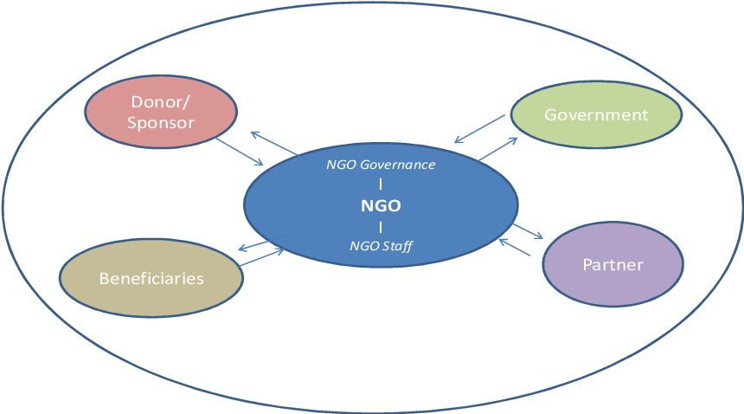
Accountability

Slide 6
To whom, or to what is an NGO accountable?
A donor agency, in the use of funds received for the intended objectives and purposes. Accountability UP
A government regulatory agency, in terms of maintaining its "non-profit" status and providing documentary evidence of its expenditures. Accountability UP.
Its constituency, in terms of delivering on its projects and assisting them in finding solutions to the problems that they are facing. Accountability DOWN.
Organisational accountability to the broader society by transparently clarifying its goals and objectives, and reporting on its activities and actions.
Accountability UP and WITHIN.
To its team of employees and volunteers. For setting good standards of professionalism, for promoting a culture of well being within the organisation.
Accountability WITHIN.

Slide 7

Organisational accountability
Organizational accountability is about defining the company's mission, values, and goals, as well as everyone's role in working toward them. It's about holding employees and executives responsible for accomplishing these goals, completing assignments, and making decisions that deliver on these expectations.

Slide 8
Instruments / illustrations of organisational accountability
Project documents
Financial receipts and statements
Multimedia resources such as text, images or videos
Meeting minutes reflecting decisions and reports
Activity outputs such as publications and products
Mass media articles
Bye-laws of the NGO
Government rules and laws related to NGOs

Slide 9

Accountability to donors
NGOs are accountable to their donors for honouring the terms of the funding contract, and by continuing to act in the best interests of the intended beneficiaries and acting within the law.
For formal upward accountability to donors, NGOs use annual reports, interim reports, performance assessment reports (financial and narratives written during projects), and performance evaluation reports.

Slide 10
Accountability to the government or regulatory authority and to wider society
The organisation has a duty to the government and / or regulatory authority to clarify its objectives and principles. It operates within the law.
It is transparent. Its governance and management structures are open to scrutiny, it publishes and publishes its programme and financial reports, it pays its taxes on time. It is legally registered and acts within its mandate. It strives to be a good citizen.
It has in place legal instruments, policies, mandates, values, legislative provisions, rules and regulations. This could also be in the form of processes covering the way work is done, the disbursement and deployment of resources and accounting etc.

Slide 11

Accountability to the team
Internal Accountability
One of the most important aspects of accountability is to be answerable to your own employees and volunteers and your organization’s mission. It means that you have ethical standards and governance structures that complement your organization’s core values.
Recruitment is open and fair.
There is a suite of human resource policies.
Employees sign a contract.
Volunteers sign an agreement
They are protected by employment legislation or organisational best practice.
The employer promotes and nurtures and promotes a strong safeguarding culture.

Slide 12
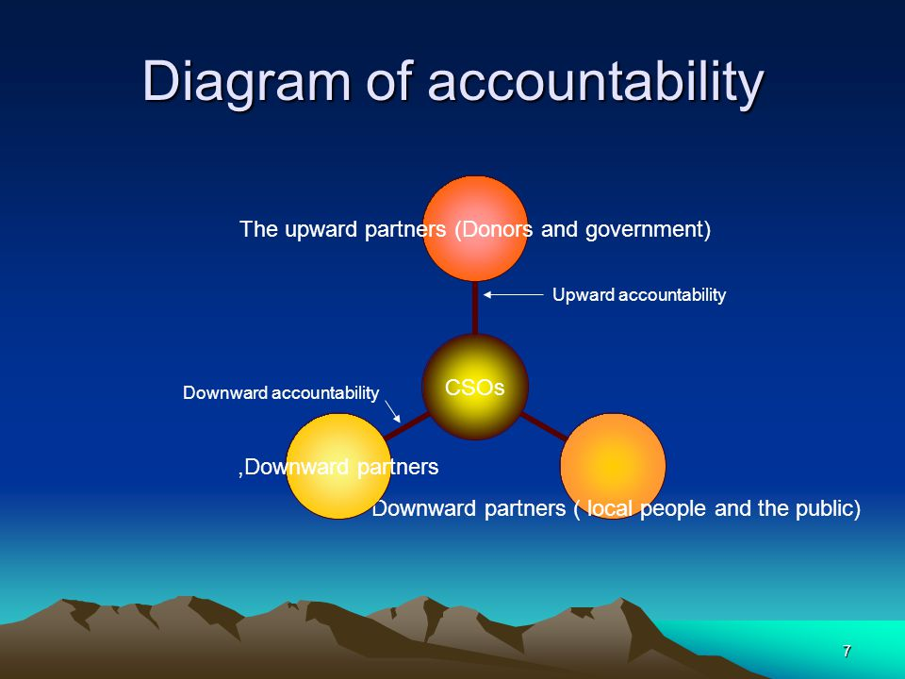
How do we understand downward accountability?
Downward accountability refers to “the ability of citizens to hold the local authority to account”

Slide 13

What is beneficiary accountability?
Being accountable to beneficiaries involves providing all those potentially affected with the opportunity access services to understand and influence the key decisions which are made throughout the project's lifetime.
It is a dynamic process of listening to beneficiaries and adapting and responding.

Slide 14
How to make a reality of downward accountability to the beneficiaries.
Involving the community in identifying the problems to be addressed and how best to address them. Rereferred to as co-creation.
By valuing the community’s input – making it meaningful by enabling members to speak up and contribute.
By being open about what can and cannot be done. By being honest and transparent.
Delivering on its projects and involving programme beneficiaries to find solutions to the problems that they are facing.
Through community members that are appointed as fieldworkers.
Open house policy for all beneficiaries to attend any meeting of the organisation
In community meetings where the beneficiaries come together and talk about the process, what is needed, what is lacking and what should be done.
Through public meetings.
Independent feedback but not expensive M&E.
Social audits and public hearings.
Sometimes unplanned and stumbling on the issues!

Slide 15
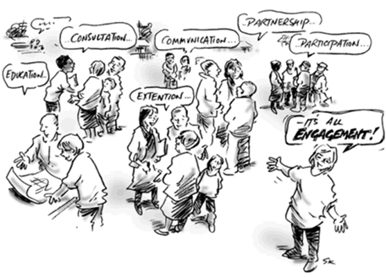
This is sometimes referred to as a community engagement strategy
Community engagement involves processes that enable communities in making decisions that can lead to improvements in the quality of their life. It allows them to take part in shaping the places in which they live and the services they receive.
Why is community engagement important? An effective community engagement strategy can:
Build trust and respect
Convey to service users that they are contributors
Increase loyalty to your NGO and win support from donors / the government
Empower community members to make required changes
Provide access to multiple perspectives and expertise
Create a culture of collaboration
Improve communication within the community and between it and your organisation.
Lead to sustainable changes

Slide 16
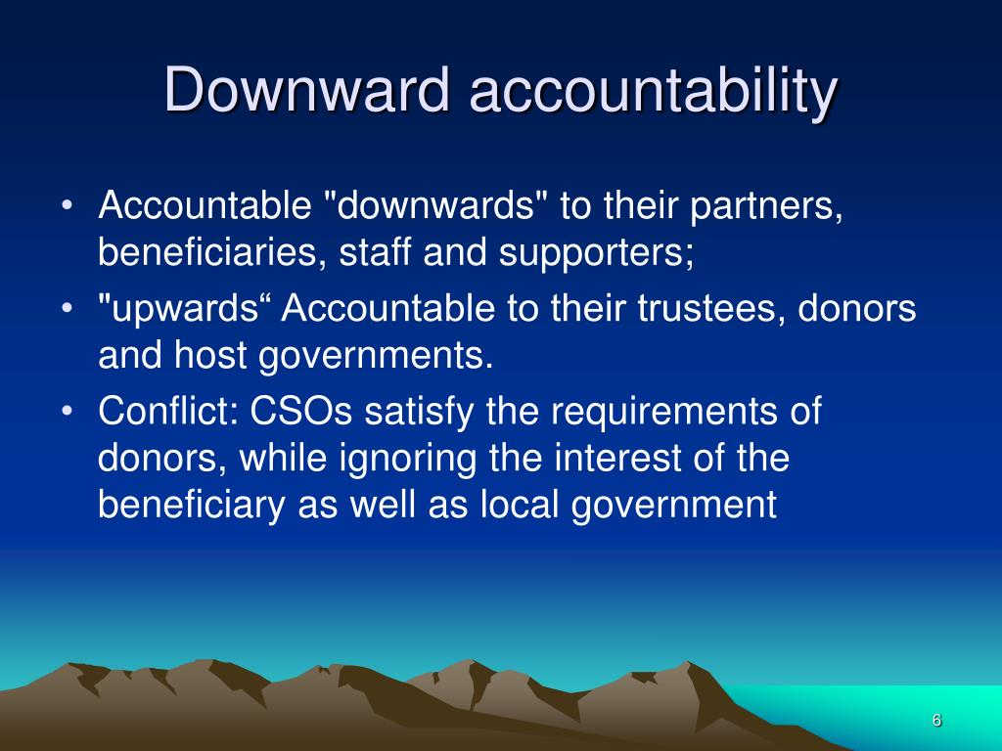
Share examples of community accountability in your organisation
What tools do you use?
What do you do well?
What challenges do you face?
How could you overcome them?
What could you improve on?

Slide 17


Slide 18


