Slide 1
Monitoring, Evaluation, Accountability and Learning A three day training course for partners of Terre des hommes in Gaza December 6 to 8, 2022
Social Development Consulting, UK

Slide 2
Welcome to MEAL
Monitoring and evaluation (M&E) is the backbone of any development intervention—it ensures high-quality implementation, provides timely information for informed management decisions, and measures contributions to outcomes and impacts. M&E and MEAL are often used interchangeably depending on contexts and programme needs.
Over time, the M&E moniker has been augmented to include accountability and learning. Most development agencies, therefore, began using monitoring, evaluation, accountability and learning (MEAL) in place of M&E.

Slide 3
Thinking about project planning

Slide 4
Warm up Exercise:
You want to know ‘How well is my child doing at school?’.
What monitoring tools do you use to find out?

Slide 5
How well is my child doing at school?
Outcome | Indicators | Quantitative monitoring tools used | Qualitative monitoring tools used
My child ‘succeeds’ at school | Child demonstrates academic abilities | Homework markings shows good results (internal / external measurement) Test results in class (internal assessment and comparison with peer group)
 |  | Exam results (externally assessed) Wins scholarship to Uni (externally assessed) Wins place at Uni (external recognition of success)
 | Child is ‘happy’ and socially well adjusted |  | Feedback from child Parental observation of child: Eager to attend school Little sign of stress Does not report bullying Makes and maintains friendship Is popular with peers (invited to birthday parties, etc) Plays happily in playground Feedback from teacher (Parent Teacher Meetings Gets work done on time Is enthusiastic about learning A good team player

Slide 6
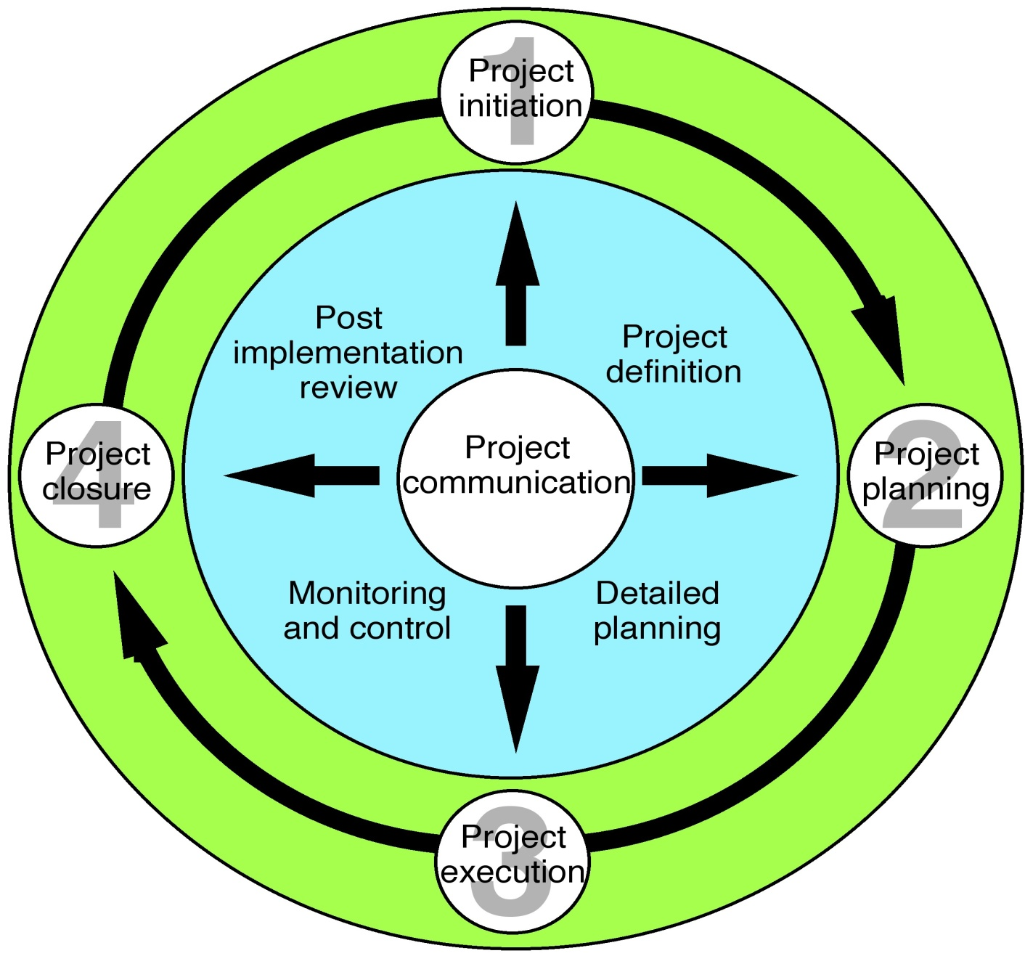
The project cycle

Slide 7
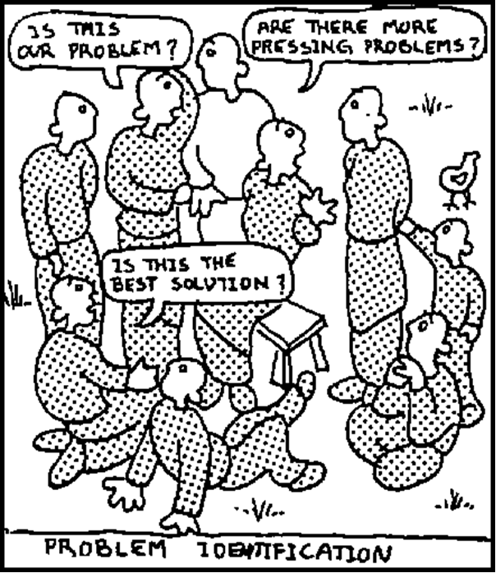
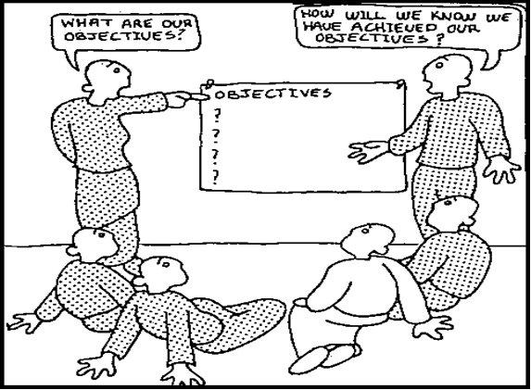
Identify the problem(s) you want to address and be sure of your objectives

Slide 8
Two popular project management tools

Slide 9
The Logical Framework
Project summary | Measurable indicators | Means of Verification | Important assumptions
Goal: Overall goal which this project will help to achieve | The evidence (quantitative/qualitative/time) which will be used to measure/judge the achievement of goal | Sources of information/data which will be used to assess the indicators | Main external factors necessary to sustain objectives in the long run
Purpose: Immediate impact on the project area or target group i.e. the change or benefit to be achieved by the project | The evidence (quantitative/qualitative/time) which will be used to measure/judge the achievement of the purpose | Sources of information/data which will be used to assess the indicator(s) | Main external factors necessary if project purpose is to contribute to reaching project goal
Outcomes The specific deliverable results expected from the project to attain the purpose | The evidence (quantitative/qualitative/time) which will be used to measure/judge the achievement of the outputs | Sources of information/data which will be used to asses the indicator(s) | Main external factors necessary for outputs to achieve project purpose
Activities These are the tasks to be done to produce the outputs | Inputs This is a summary of the project budget and other key inputs | Sources of information/data which will be used to assess the indicator(s) | Main external factors necessary for activities to achieve project outputs

Slide 10
An alternative Logical Framework
Project summary | Measurable indicators | Means of Verification | External Risks | Risk Mitigation
Goal: Overall goal which this project will help to achieve | The evidence (quantitative/qualitative) which will be used to measure/judge the achievement of goal | Sources of information/data which will be used to assess the indicators | Main external threats to the achievement of impact | The steps you will take to reduce external threats, or their impact
Purpose: Immediate impact on the project area or target group i.e. the change or benefit to be achieved by the project | The evidence (quantitative/qualitative) which will be used to measure/judge the achievement of the purpose | Sources of information/data which will be used to assess the indicator(s) | Main external threats to the project reaching its goal | The steps you will take to reduce external threats, or their impact
Outcomes The specific deliverable results expected from the project to attain the purpose | The evidence (quantitative/qualitative) which will be used to measure/judge the achievement of the outputs | Sources of information/data which will be used to asses the indicator(s) | Main external threats to the project reaching is purpose | The steps you will take to reduce external threats, or their impact
Activities These are the tasks to be done to produce the outputs | Inputs This is a summary of the project budget and other key inputs | Sources of information/data which will be used to assess the indicator(s) | Main external threats to the project achieving its outcomes | The steps you will take to reduce external threats, or their impact

Slide 11
Every project and programme expects some changes in someone’s life directly or indirectly. The key element in this approach is to establish clearly the relationship between the expected changes and the activities. Please see the paper: Theories of Change and the Log frame
Theory of Change

Slide 12
What is a ‘Theory of Change’
An ongoing process of reflection to explore change and how it happens – and what that means for the part organizations play in a particular context, sector and/or group of people.
It locates a programme or project within a wider analysis of how change comes about.
It draws on external learning about development.
It articulates organizations' understanding of change – but also challenges them to explore it further.
It acknowledges the complexity of change: the wider systems and actors that influence it
It is often presented in diagrammatic form with an accompanying narrative summary

Slide 13
What do Theories of Change look like?

Slide 14
Another example of how a Theory of change can be presented

Slide 15
Thinking about Monitoring, Evaluation and Learning

Slide 16
Key Terms
Assessment (needs assessment, or context analysis)
This is the process of identifying and understanding a problem and planning a series of actions to deal with it. This will require the collection of information and may involve a number of processes such as the development of a problem tree and an objective tree. The end result will be a hierarchy of objectives (goal, purpose, outcomes) and specific activities to achieve these objectives, i.e. a Logical Framework Analysis. As part of the process it is likely you will develop ‘Base Line Data’.
Monitoring
This is the systematic and continuous collecting and analysing of information about the progress of a piece of work over time. It is a tool for identifying strengths and weaknesses and providing sufficient information so that decisions can be made to correct weaknesses.
Review
This is the assessment at one point in time of the progress of a piece of work. Reviews look in detail at different aspects of a piece of work and use different criteria to measure progress.

Slide 17
Key Terms, continued
Evaluation
This is very similar to a review, but more formal. It concentrates specifically on whether the objectives of a piece of work have been achieved and what impact has been made.
There is a considerable amount of overlap in these processes and sometimes the words are used by different individuals and agencies to mean slightly different things. For example, monitoring, evaluation and taking action to correct a situation may take place almost simultaneously.
Learning (sometimes called capitalisation or lessons learnt)
Often quite different from the ‘simple 'monitoring of your indicators, learning examines the ‘bigger pictures’ often hidden away in your project.

Slide 18
Some more on Learning
Learning is a key success factor for refining programming by adding value for improvement, revising strategies, and updating plans and frameworks based on key lessons learnt, findings and recommendations.
Learning primarily contributes to generating knowledge products, disseminating information, and helping both internal and external programme/project stakeholders use adaptive programming.

Slide 19
Gantt or ‘Timebar Chart’
Gantt or ‘Timebar’ chart
 | Timeframe (can be months or quarters, depending on what is needed)
Activity | Jan | Feb | Mar | Apr | May | Jun | July | Aug | Sept | Oct | Nov | Dec | Lead person/agency
Related to programme preparation
Related to outcome 1 (taken from the logical framework)
Related to outcome 2 (taken from the logical framework)
Related to outcome 3 (taken from the logical framework)
Related to reporting, monitoring and evaluation

Slide 20
Simple project monitoring tools for use in the field
Results based monitoring framework
Project narrative | Indicators | Measurement tools used | Problems faced by the project and how overcome | Main findings (is the project on course or not?) | Budgetary concerns | Lessons learned | Action to be applied for correction
Goal
Outcome 1 | Indicator 1
 | Indicator 2
 | Indicator 3
 | Indicator 4
Outcome 2 | Indicator 1
 | Indicator 2
 | Indicator 3
 | Indicator 4
Outcome 3 | Indicator 1
 | Indicator 2
 | Indicator 3

Slide 21
Qualitative and Quantitative measurement tools
Quantitative research | Qualitative research
Surveys and questionnaires with closed-ended questions: - Categorical questions (i.e. yes/no, checkbox or multiple choice) - Questions with intervals or ratios (i.e. choosing from 1-5) | Surveys and questionnaires with open-ended questions (i.e. describe in your own words). Also: - Focus group interviews - Key Informant Interviews - Observation (watching people as they go about their work or life)
Narrow in focus | Broad in focus
Facts and numbers | Impressions, opinions and views

Slide 22
Risk

Slide 23
Risk
Risk management is an inherent part of project management.
All projects go through a planning phase. Their complexity depends on the scope and complexity of the project.
Any uncertainty related to the assumptions that inform the project is a source of risk. If these uncertainties are considered seriously, and planned for, their effects can be ‘controlled’, or minimized.
Project managers most often do this by making sure project plans consider the likelihood and impact of a risk.
Compared to projects in other areas, international development projects have greater exposure to risk. This is because the operating environments for such projects are difficult and often with inadequate resources.
In addition, most of these projects are funded by donors, who come with their own requirements that may require additional resources.

Slide 24
Probability / Risk Impact Grids

Slide 25
Community Engagement

